Slide 1
HOT Data Quality Internship 2021
Welcome!
Notes:
Introductions; Sam, Becky, Carly
10 mins, everyone introduces their name, where they're from and possibly shares 1 thing (I'll let you decide what!) note would need to be tight on time!

Slide 2
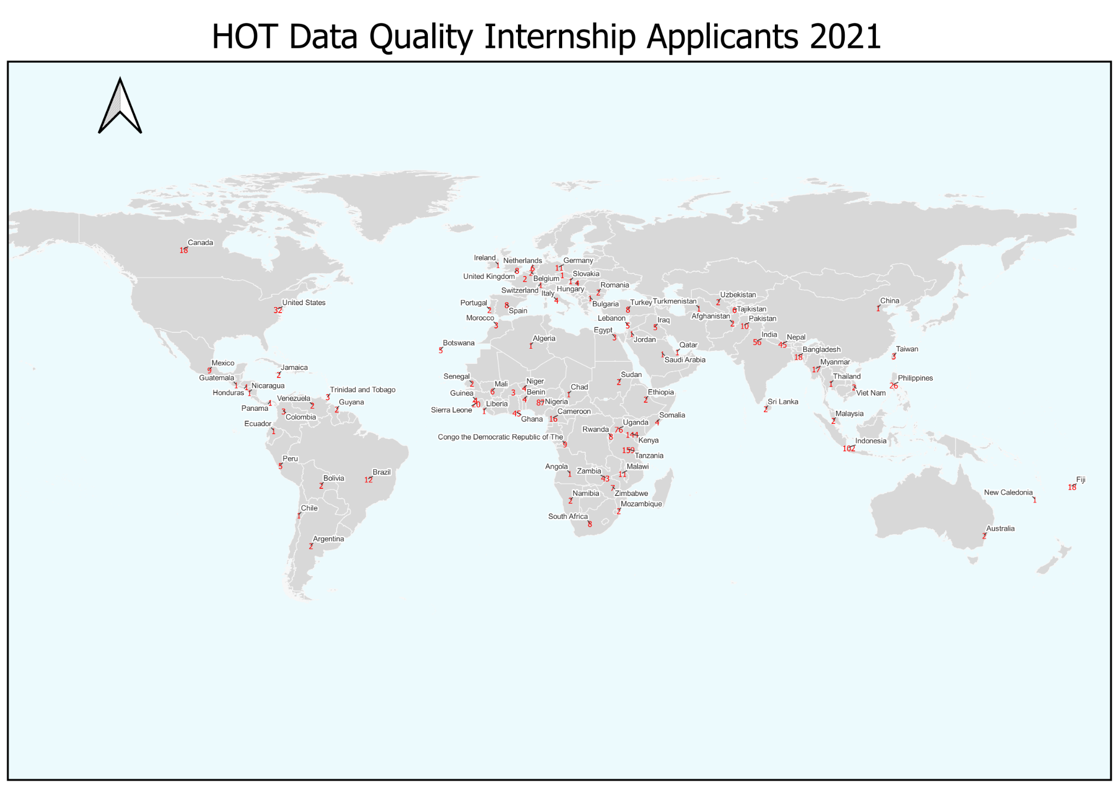
Internship applicants: 1,174 from 92 countries
Notes:
Sam takes over
https://rebecca-chandy6.carto.com/builder/ac416b76-db4b-49ad-968d-6ea142f4f26b/embed

Slide 3
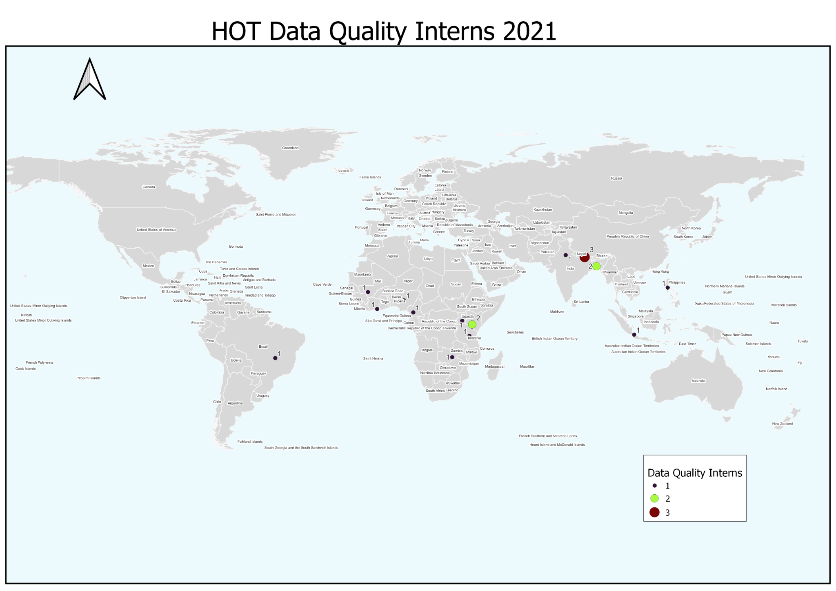
Congratulations on being selected as HOT’s 2021 interns!
20 interns in 15 countries

Slide 4
About HOT

Slide 5
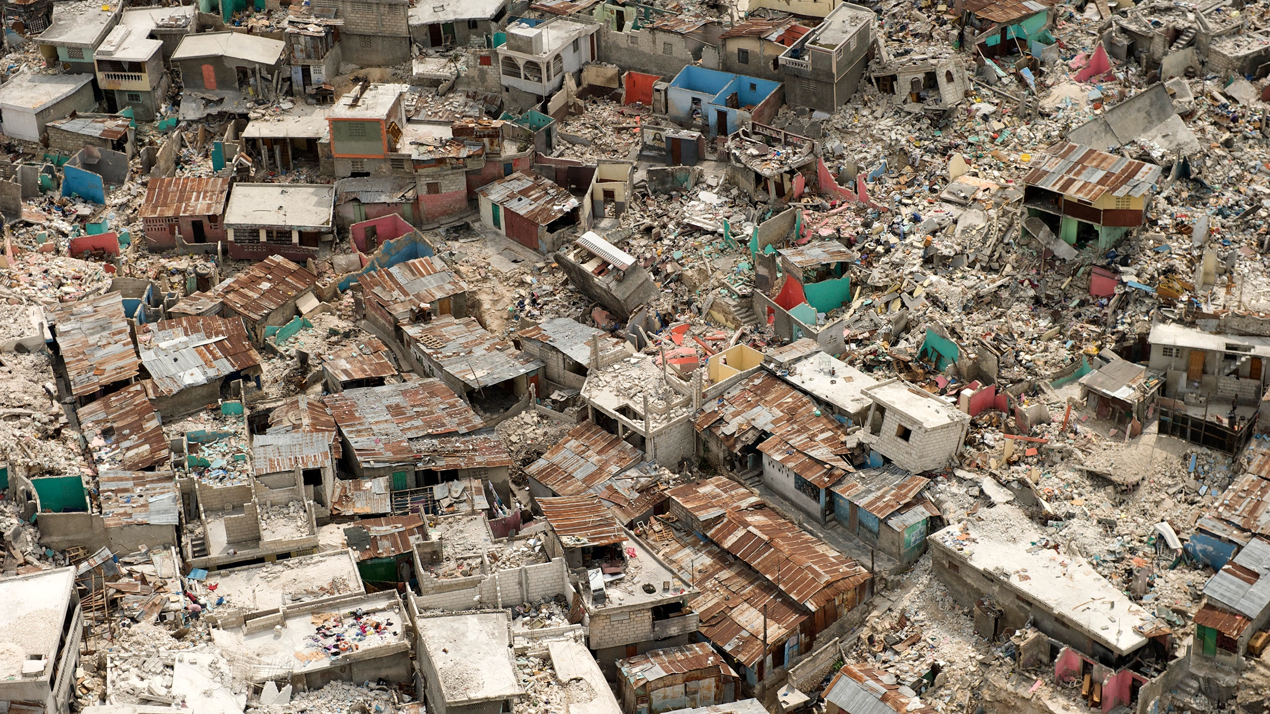
HOT is an NGO which supports communities and OpenStreetMap contributors, mapping areas vulnerable to disaster and affected by poverty
Notes:
NGO which supports communities and OpenStreetMap contributors, mapping areas vulnerable to disaster and affected by poverty
Many of the locations vulnerable to disaster - and where services, such as education, health, water and sanitation, are least accessible to the population - are often the least mapped (they might rely on outdated hand drawn map). Maps are critical in the hours, days, and weeks after a disaster.
In terms of a digital map, OpenStreetMap is often the most accurate map source there is. We’re working with OSM and communities to build a free and open map of the world - OpenStreetMap or OSM.
By combining OpenStreetMap, open source tools, and local knowledge, we support mapping communities worldwide, and create and provide data and maps to improve humanitarian action, disaster response and development.

Slide 6
We’re working towards a world where...
Everyone is counted
Map data is accessible and used in decisions that save and improve lives
Everyone can engage and contribute to the map
Notes:
That’s why we’re working towards a world where….
Everyone is counted
Map data is accessible and used in decisions that save and improve lives
Everyone can engage and contribute to the map
We recognise we can’t do this alone. We need to partner with communities, govts, NGOs, and volunteer networks to ensure map data is available and used, and that local people can lead on local problems that matter to them

Slide 7
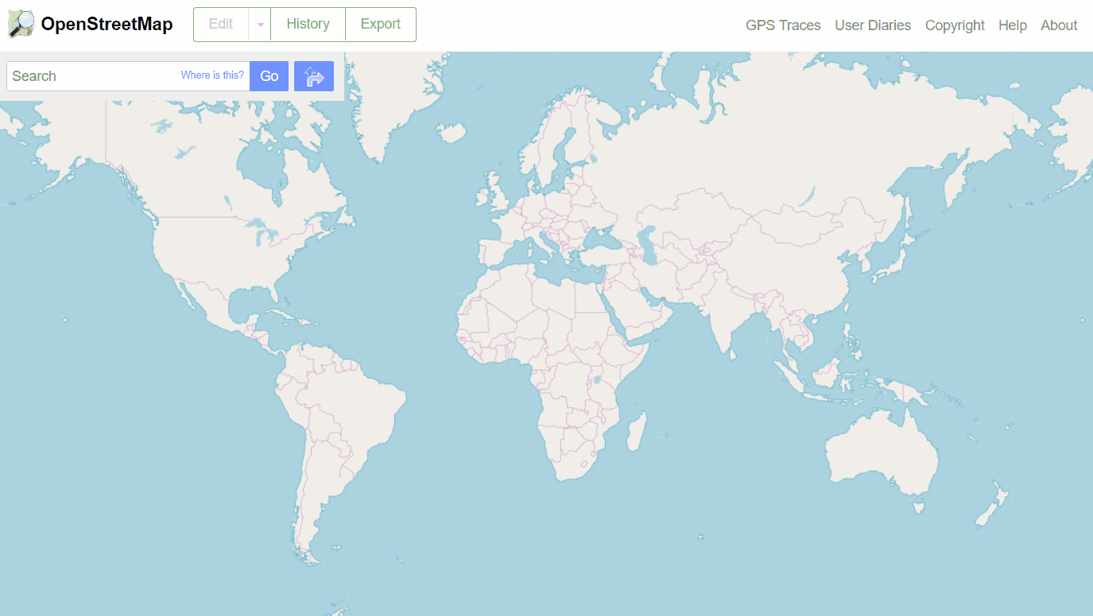
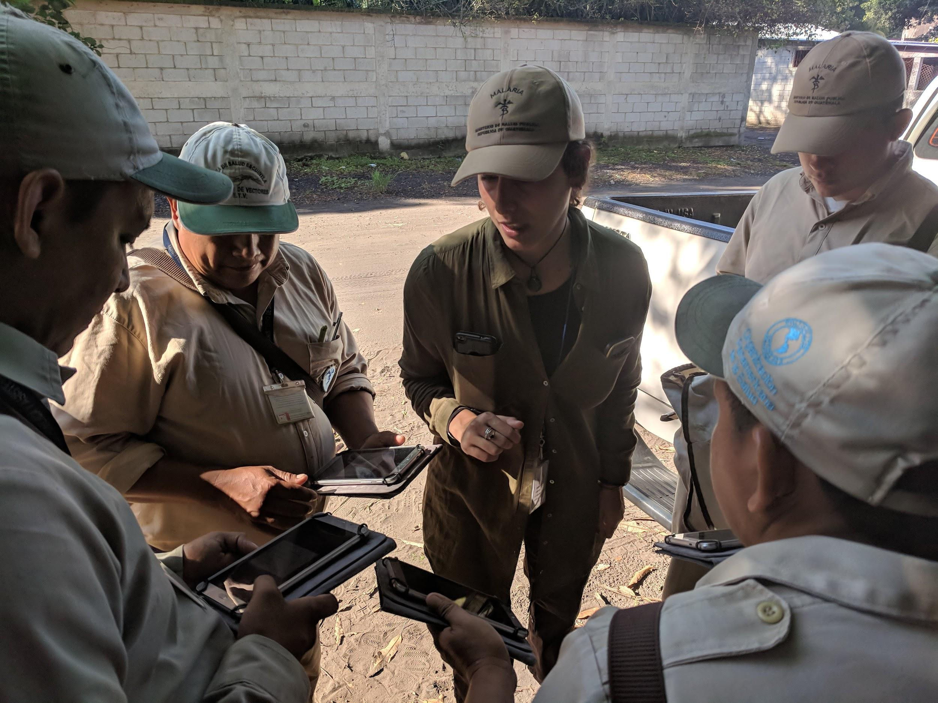
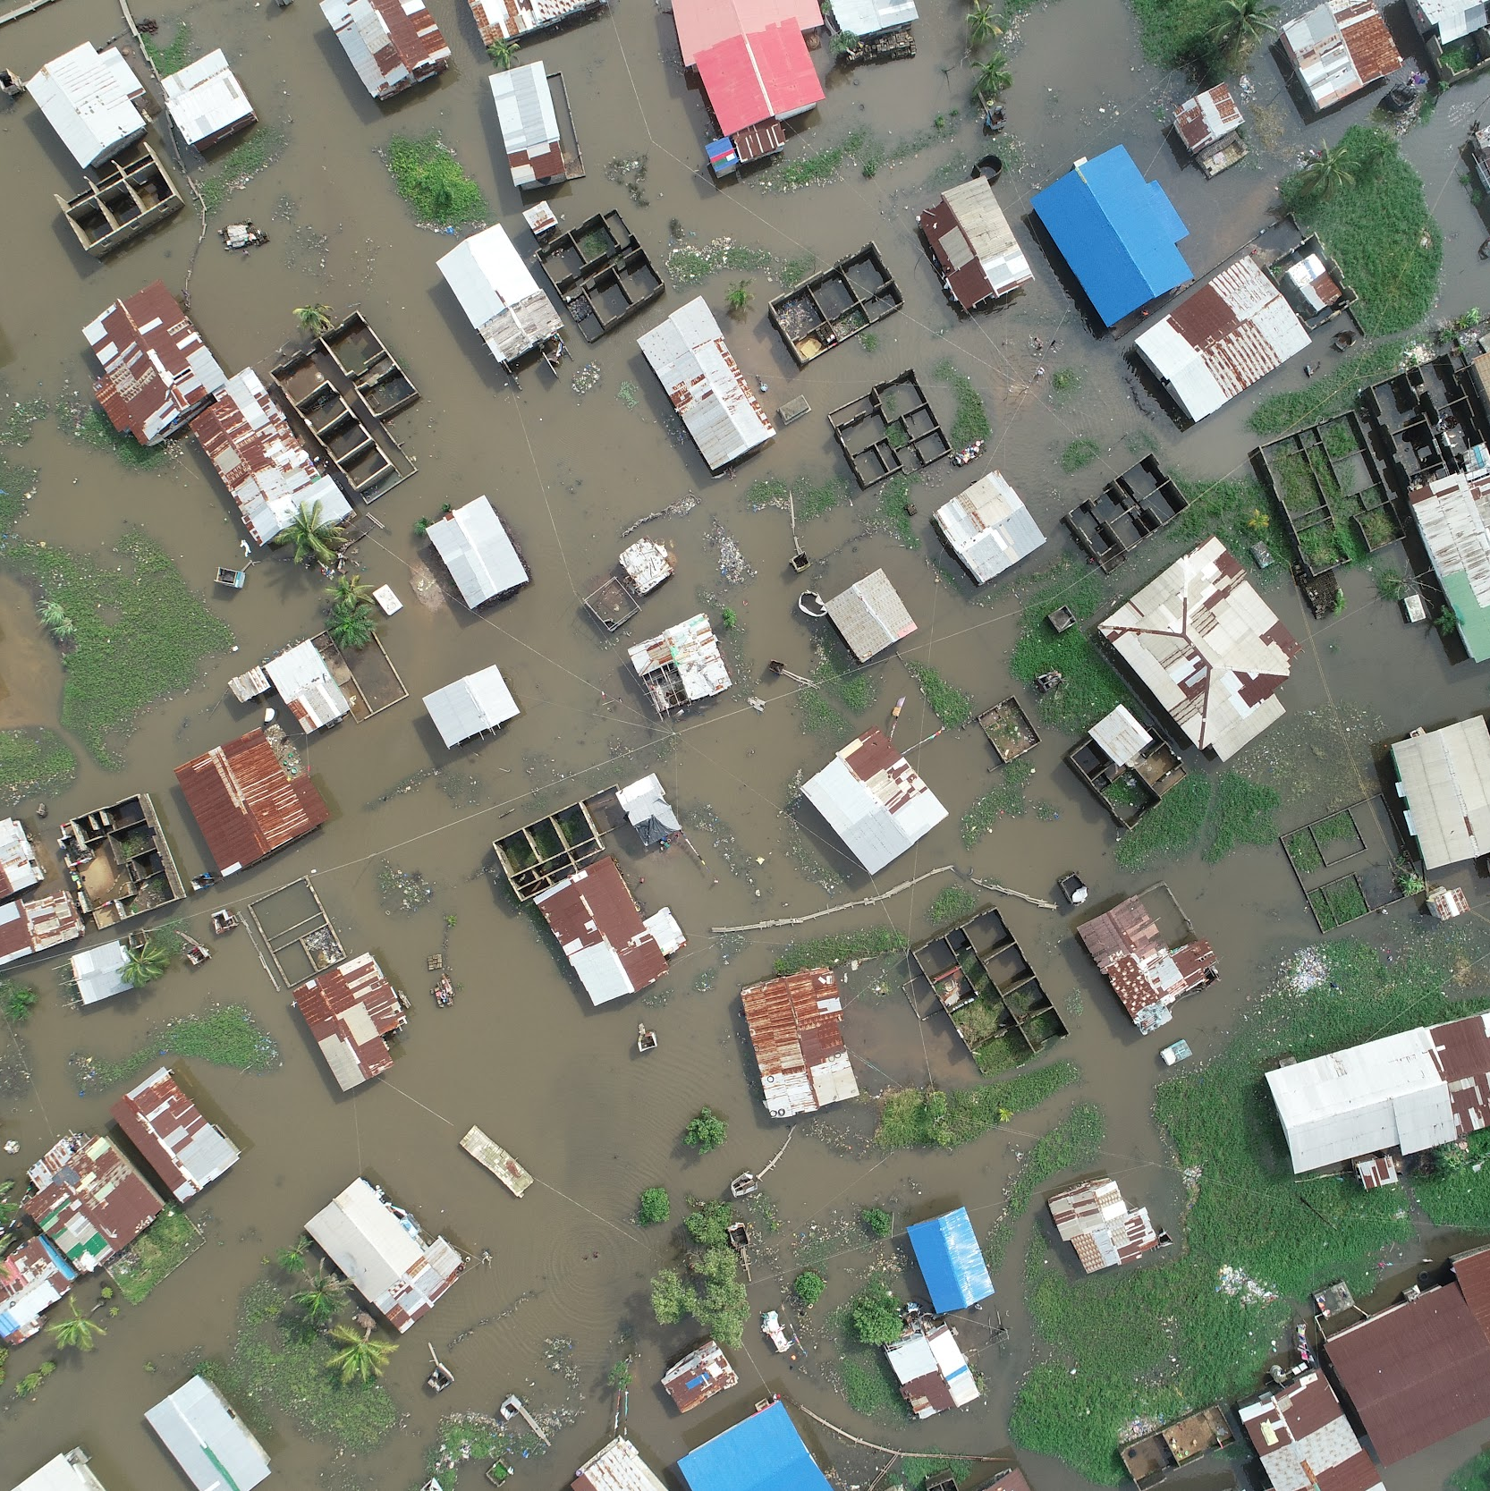
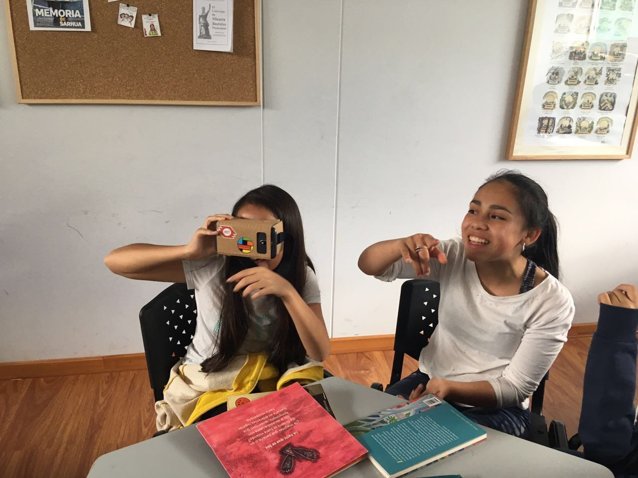
OpenStreetMap
is a collaborative project to create a free editable map & source of geospatial data.
CLIMATE CHANGE
FLOOD RESILIENCE
GENDER EQUALITY
Notes:
We’re working together to build a free and open map of the world - using OpenStreetMap (the map you can see in the background) which is like the Wikipedia of maps. It’s a PUBLIC GOOD so that valuable data can be used by all local actors. That means all data on OpenStreetMap is free and open to access, use, download, incorporate in offline analysis, applications, etc.
I mentioned that maps are critical in the hours, days, and weeks after a disaster. But they are also key in anticipatory action e.g. to help community on preparedness for the next major disaster.
Some examples of projects we’ve worked on, include:
Environmental mapping projects that help monitor change in environmental features such as coastal erosion, wetlands, and local biodiversity to tackle issues such as climate change and flooding.
Mapping for disaster risk resilience. Our colleauges in the Philippines, the third most disaster-prone country in the world, have been working with local governments to create preparedness plans that build resilience.
November 2020 natural disasters like Hurricane Eta (Ay-ta) brought wind, rain and storm surge to the coast of Nicaragua. Volunteers can map to help first responders understand where there is flooding and landslides.
We’re also supporting inclusion projects from: from pursuing LGBTQ inclusion and representation in mapping, to empowering women and girls to create gendered data about issues affecting their lives
An example of a community development organisation is Crowd2map Tanzania, who have been helping to end FGM in Tanzania through mapping rural areas. To get help to girls and women who are at risk, FGM activists and the police need better maps
NEXT SLIDE
OLD NOTES
---------------
SINCE WE BEGAN, WE’VE SUPPORTED ORGANIZATION'S ACROSS A WHOLE RANGE OF IMPACT AREAS -- RELEVANT TO MOST SDGS
---------
Example projects include:
Environmental mapping projects that help monitor change in environmental features such as coastal erosion, wetlands, and local biodiversity to tackle issues such as climate change and flooding.
In the Philippines. the third most disaster-prone country in the world, teams have been mapping to help local governments to create preparedness plans that build resilience.
Natural disasters like Hurricane Eta (Ay-ta) in late 2020 brought wind, rain and storm surge to the coast of Nicaragua. Volunteers mapped to help first responders understand where there is flooding and landslides.
Other projects like Open Cities generating actionable data on flood history, drainage capacity, services and more
Notes:
HOT has been contributing to the development of PhilAWARE, a custom hazard monitoring and early warning system to improve disaster management and decision making in the Philippines. It consolidates hazard information and alerts from various sources for the agencies’ disaster preparedness and response. This will also ease the sharing of information among the country’s disaster managers from the national, regional, and local levels, with warning and alerts disseminated to the impacted communities. This example demonstrates the huge potential for OSM data to fill the data gap, enhance data maintenance and build local capacity for data readiness that can subsequently facilitate early action.
More examples:
HOT is currently working with Global Earthquake Model (GEM) (w/ World Bank) to improve availability of base datasets in Mexico City.
HOT is currently partnered with CDEMA to improve availability of open datasets for disaster resilience. Dominica, Jamaica,

Slide 8
The Next Five Years:
map an area home to one billion people living in poverty and at high risk of disaster
Notes:
The goal is to map an area home to 1 billion. By 2025, communities across 94 countries vulnerable to disaster or experiencing multidimensional poverty will be visible on the map.
In terms of impact, we’re talking about people who are systemically under represented in countries at high risk of humanitarian crisis and multi-dimensional poverty experience improved well-being, reduced suffering and increased resilience to respond to crisis through the creation, accessibility and use of geo data.

Slide 9
How:
By engaging five times more mappers and massively growing
local map edits
Notes:
How? By engaging five times more mappers and growing local map edits
In practice, that means working with local actors & communities to ensure:
That missing maps are no longer a factor in human suffering or loss of life in humanitarian crises
That communities are equipped and able to map the locations where they live and work
That decision-makers are able to rely on maps and geodata to better allocate resources for the improvement of public health, water, sanitation and hygiene, early childhood development and education, infrastructure, and better reach target communities - including the world’s children
That women and girls are fully represented on the map

Slide 10
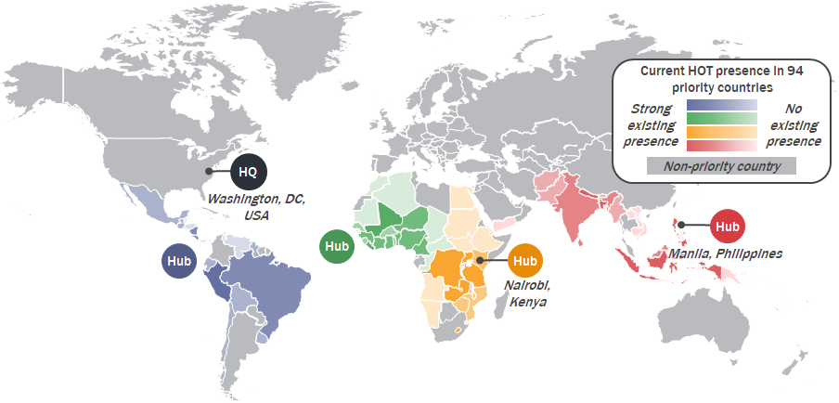
HOT will strengthen our presence in four priority regions
Countries to work in:
Asia/Pacific: 25
East Africa: 22
West Africa: 25
Latin America/Caribbean: 22
Total: 94

Slide 11
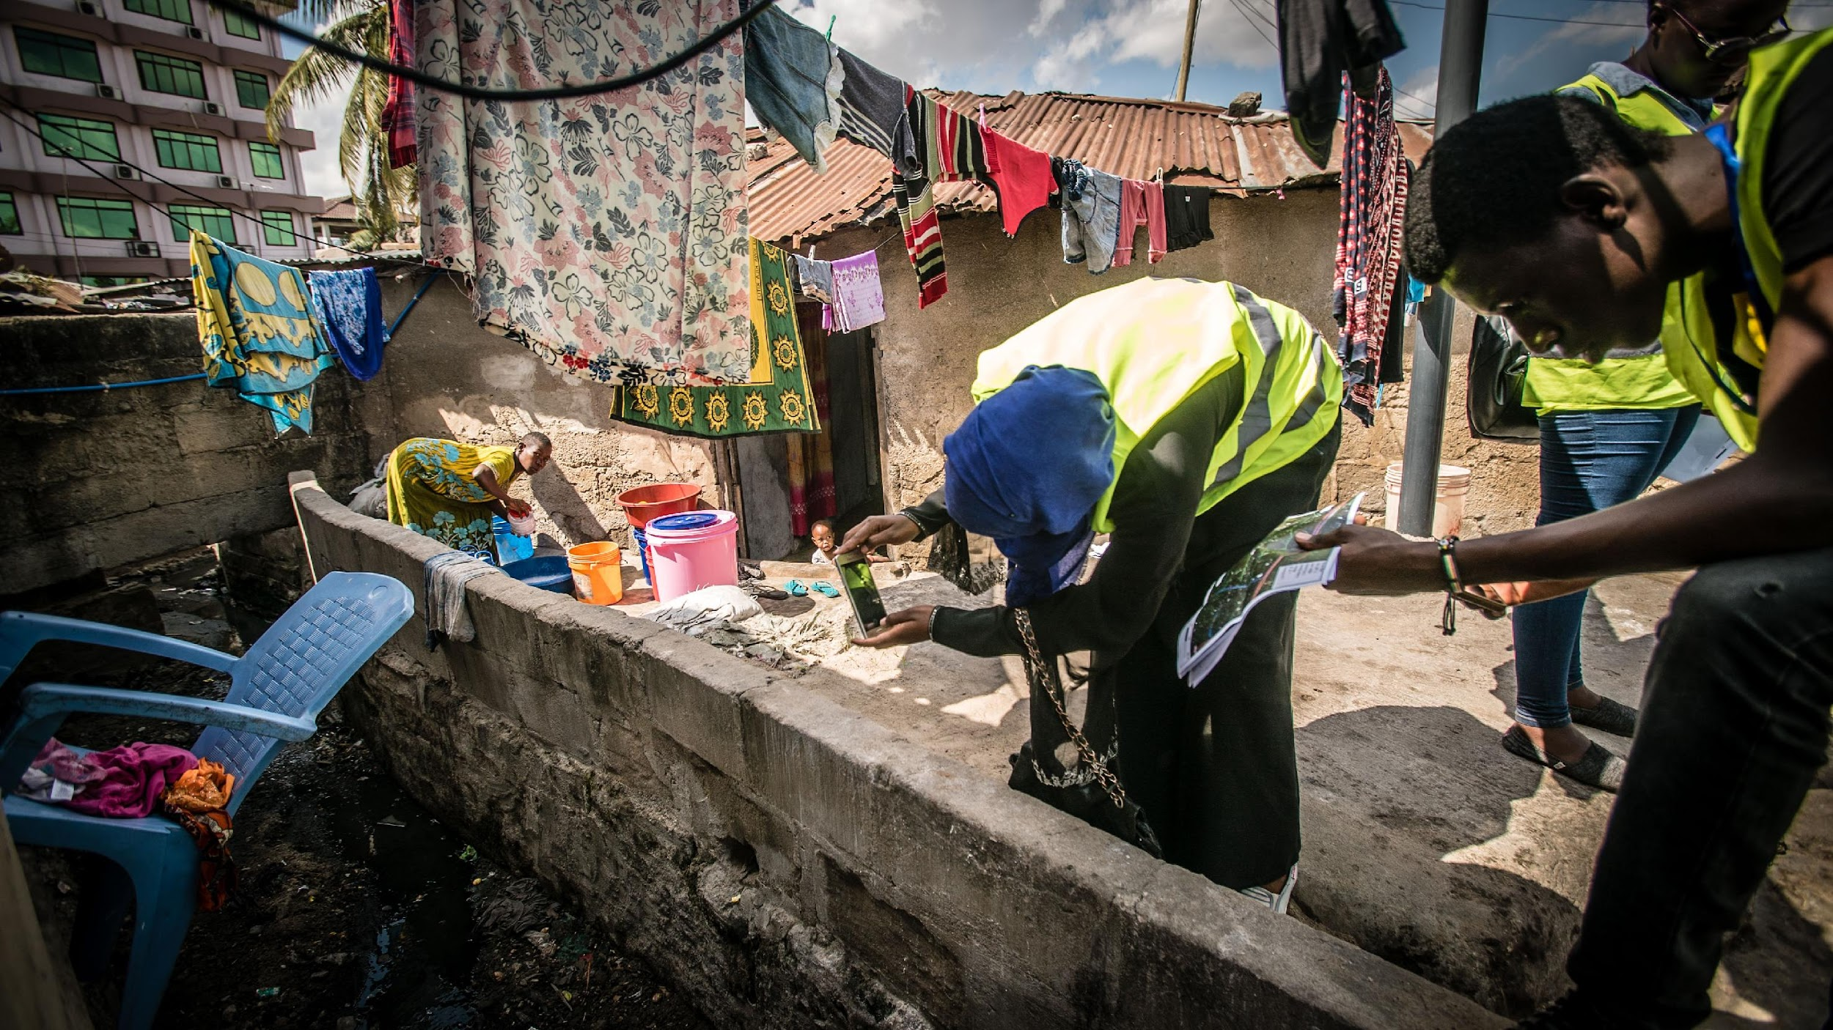
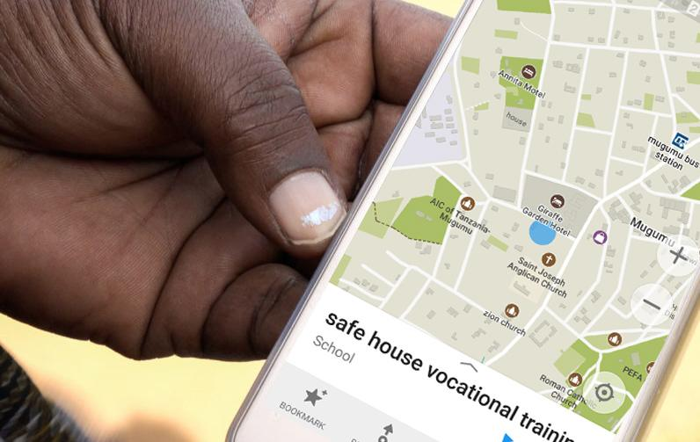
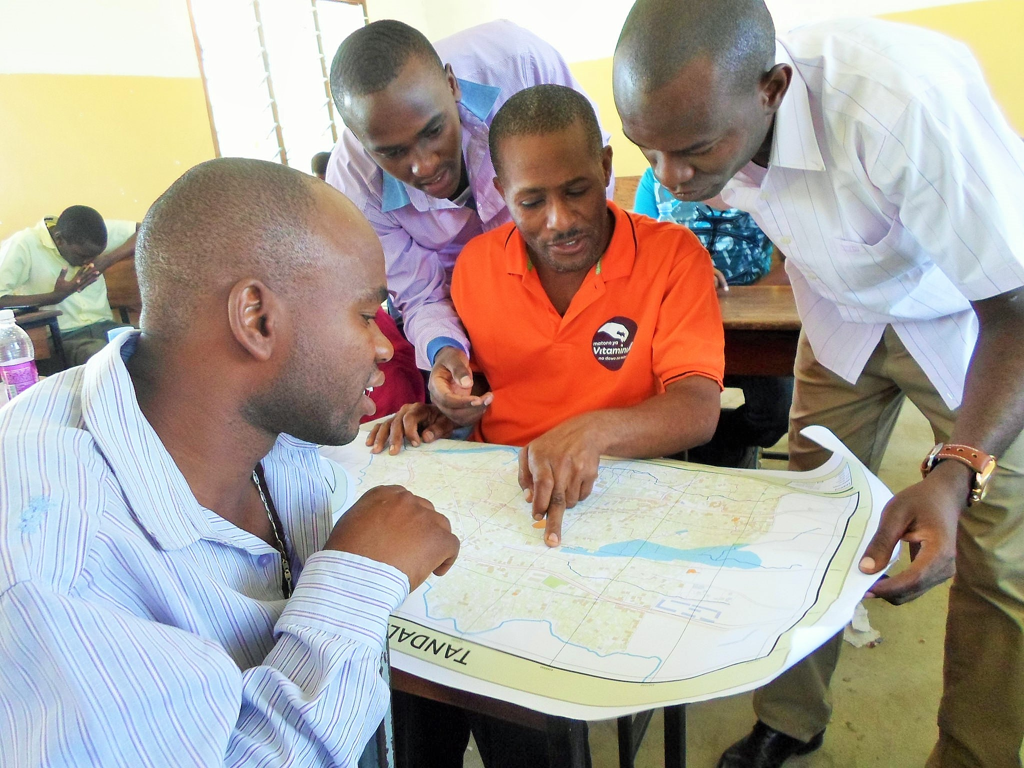
Local people & local tools: add knowledge
Community Participation
Tools
Training
with locally appropriate
methods
locally made or already owned, low tech apps
leave behind capacity for mapping to continue
Notes:
SO HOW DOES IT WORK?
Our models involves providing local people with local tools.
Community strengthening and empowerment is key -- that means sharing accessible tools and know-how so that communities can lead on mapping what’s important to them.
That includes everything from data collection, to analysis, to the maps & information can be used in gov’t policy, prioritisation, & (infrastructure) development too.

Slide 12
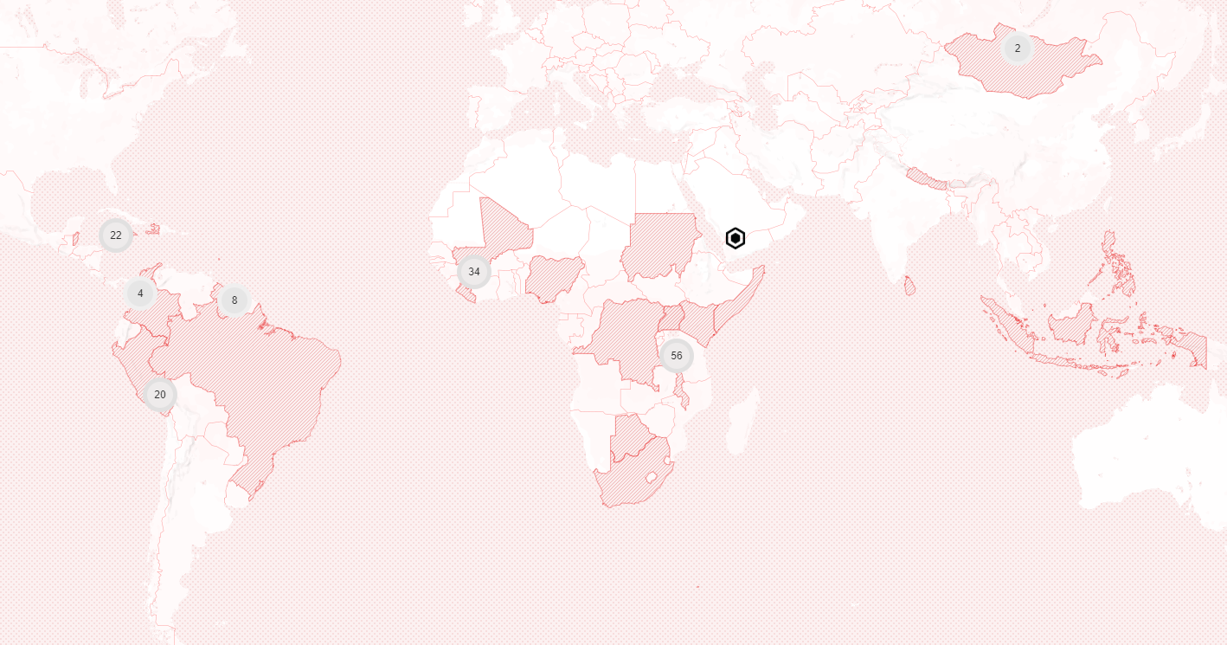
MAP DATA & COVID-19 RESPONSE
Notes:
[Sam]
Every time you see an update on Covid, you see it on a map. Covid-19 does discriminate, and maps show you how.
But what if the map doesn’t exist?
The Covid-19 response relies entirely upon testing, contact tracing, identifying vulnerable population groups and knowing where key facilities are.
We need to get this information at the micro level. Hyper-local mapping has been a cornerstone of this response. HOT coordinated with local data and mapping experts in the OpenStreetMap community, to support them with data creation.
By the end of March 2020, the Humanitarian OpenStreetMap Team (HOT) put in place a COVID-19 plan to focus on three key areas:
Help government agencies and responders to identify where unmapped vulnerable populations were located
Identify where at-risk populations of the most vulnerable people live, as well as identifying missing data on health infrastructure such as facilities, testing sites, pharmacies and laboratories
Fund local mapping groups via Rapid Response Emergency Microgrants in places most at-risk.

Slide 13
23,000 volunteers
4.2 million buildings
100,000km of roads
28 countries
Map data supported the needs of Red Cross, UN OCHA, World Bank, Caribbean Disaster / Emergency Management Agency, and 26 more local organizations
Notes:
HOT coordinated the most extensive disaster mapping activation in its history. Over the course of 2020, the response grew into a network of teams, online volunteers, national governments, and local communities supporting mapping responses around the world.
23,000 volunteers around the world helped build the map, adding 4.2 million buildings and 100,000km of roads. This map data supported the needs of Red Cross, UN OCHA, World Bank, Caribbean Disaster / Emergency Management Agency, and 26 more local organizations. In total, 28 countries have benefited from support through remote mapping, microgrants, local community efforts, and training.
I’m now going to talk through 3 case studies:
The first example is from Peru
The second example is from a partner in Liberia
The third is centered around mapping for COVID vaccination which has started in South Sudan
See map: https://hotosm.github.io/cv19_map/#

Slide 14
Data Quality Internship Program
Purpose
Learn how to use an array of open geospatial tools and skills to perform data quality assurance
Become experienced and equipped to actively participant in HOT validation community with a view to continue this
Gain transferrable & technical GIS skills
Work together to validate ~30 projects (estimate)
Notes:
Becky takes over

Slide 15
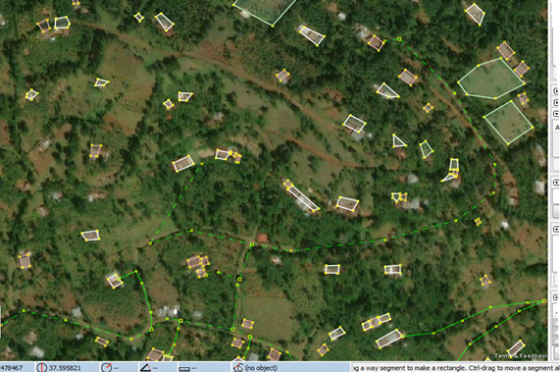
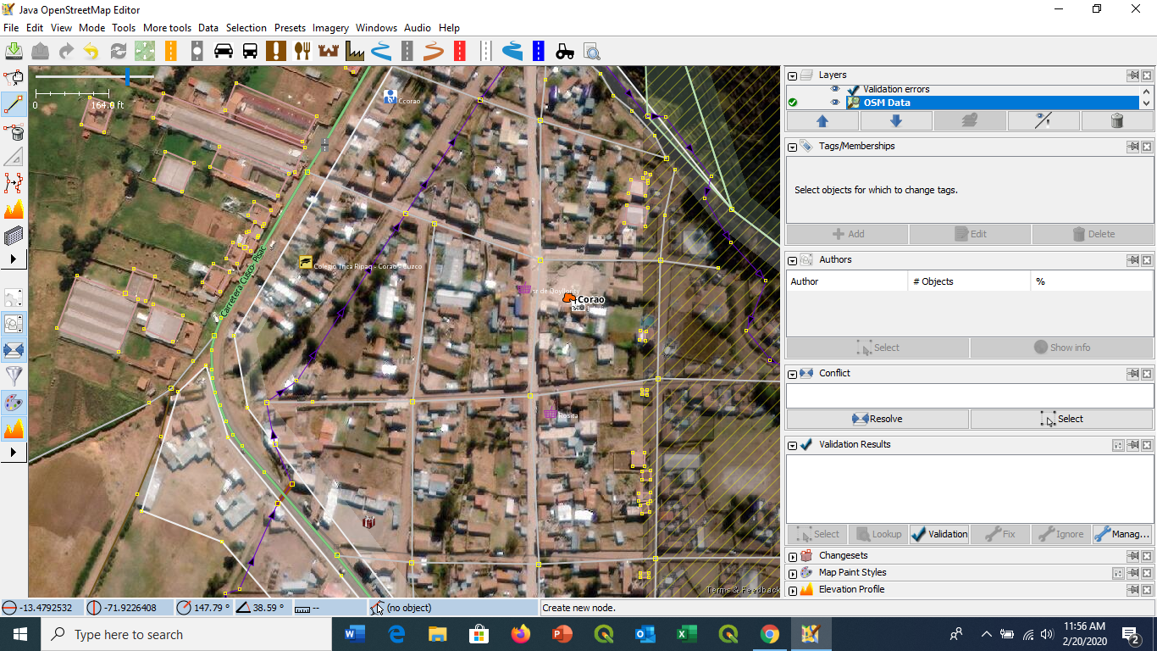
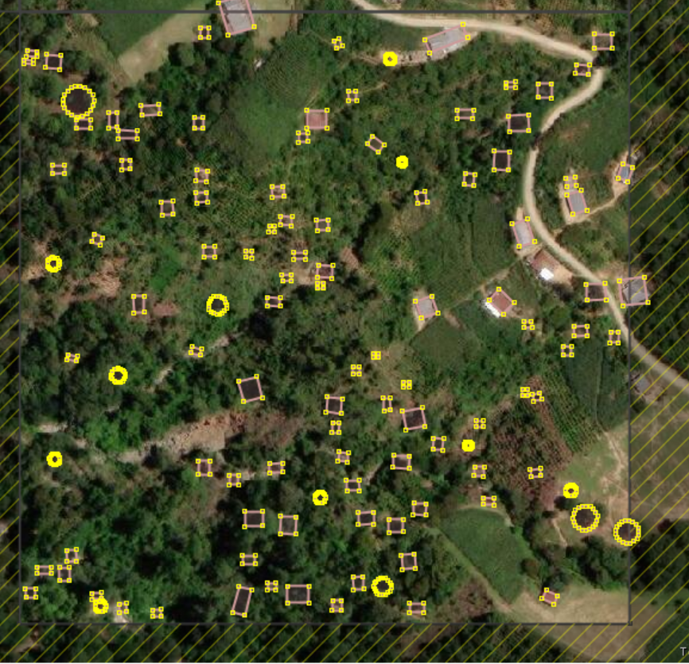
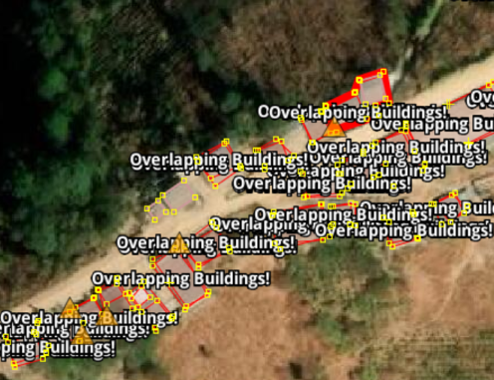
Common data quality issues
Unsquared buildings
Many buildings mapped as one
Tagging buildings as land use=residential
Tagging buildings as area=yes
Naming buildings with hashtags and osmuser name
leaving buildings unmapped and marking the tile as completely mapped
Overlapping buildings
Unconnected roads
Double mapped features
Untagged objects

Slide 16
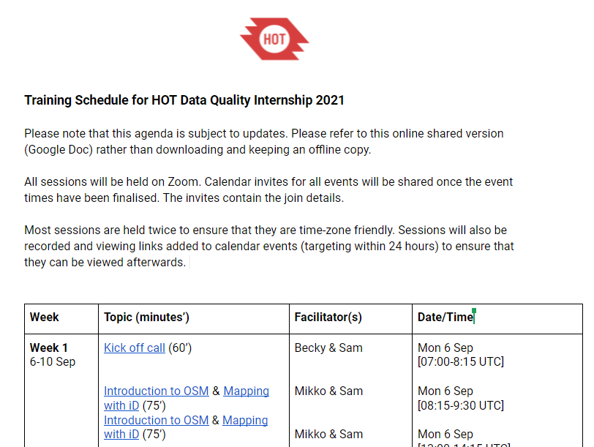
Work schedule
Workload
Schedule
40 hours per week:
Attending training sessions
Mapping
Validating
Reporting
Working Group meetings
Ask Me Anything (AMA) sessions
Coffee catch ups (Optional)
Notes:
Schedule: https://docs.google.com/document/d/1T2sO9SRILZdDQc7jEDX0pce2nqTMZxLm_TOo0drVp58/edit?usp=sharing

Slide 17
Coordination/Reporting

Slide 18
Slack
#dataqualityinternship
private channel for interns only
Coordination
Mailing List
Data Quality Internship Google Group
Zoom
Meetings and trainings every week

Slide 19
Weekly Reporting
Weekly basis by filling a Google Form, recording;
Number of buildings
Number of highways
Number of waterways
Number of landuse features
Number of natural features
Number of tasks mapped
Number of tasks validated
Weekly reflections (text response)
Notes:
Google Form: https://forms.gle/3DNYE8iVXRS3VE28A
Starting ,Monday 13 September

Slide 20
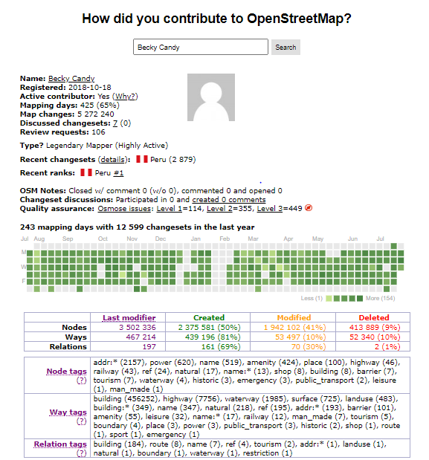
Weekly Reporting
How did you contribute to OpenStreetMap?
https://hdyc.neis-one.org/
Buildings
Highways
Waterway
Landuse
Natural
Notes:
https://hdyc.neis-one.org/

Slide 21
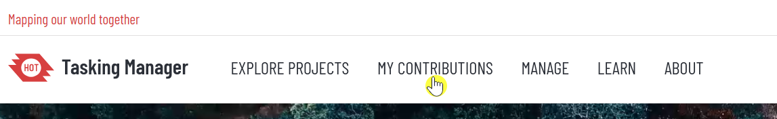
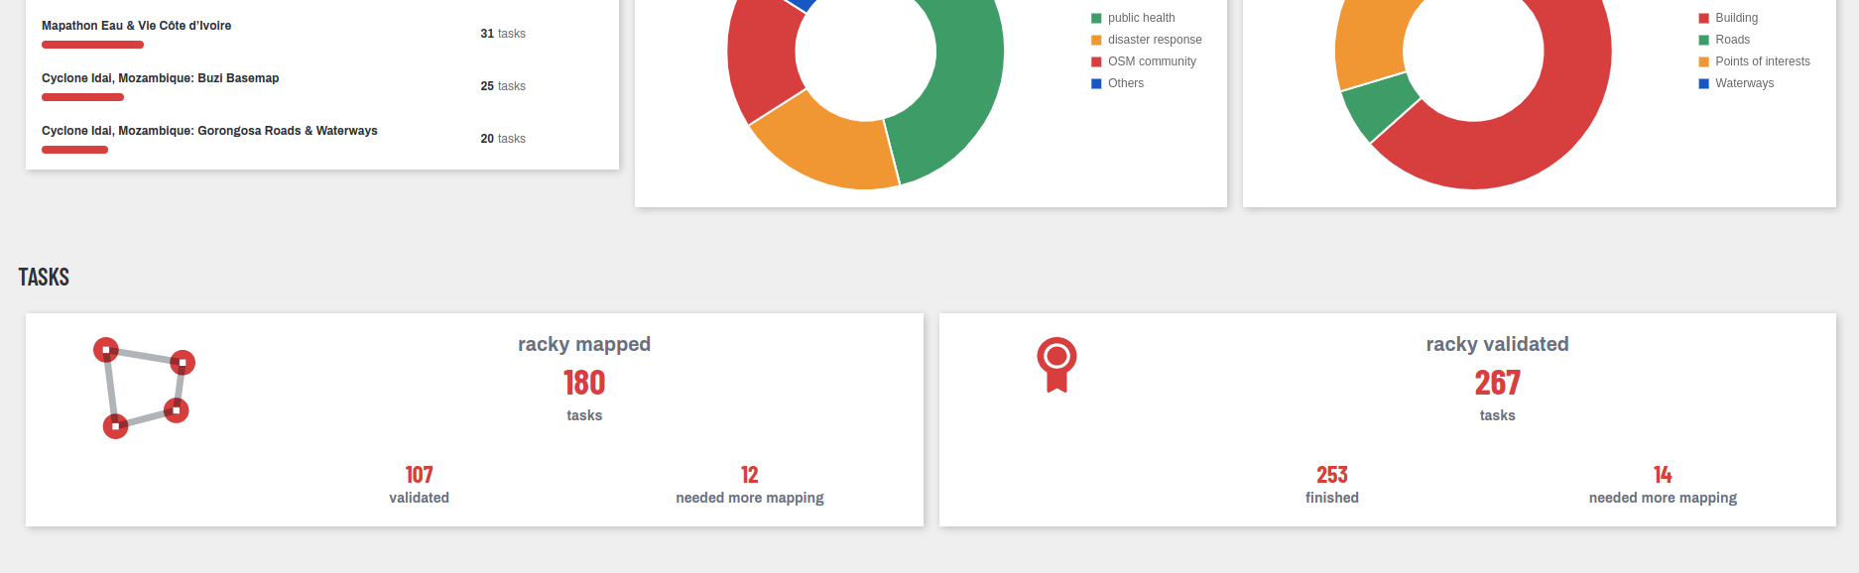
“My Contributions”on tasks.hotosm.org
Tasks Mapped & Tasks Validated
Notes:
My contributions: https://tasks.hotosm.org/contributions

Slide 22
Weekly Reflections
We want to hear how you’re finding it!
Final question in the form, anything from:
Thing you did/mapped this week?
What you learned and how you will use it?
Getting to know fellow interns / HOT staff / community member / other professionals around the world? Who did you meet? What inspired you?
Something else that was interesting/valuable - a skill/fact/a way maps are being used

Slide 23
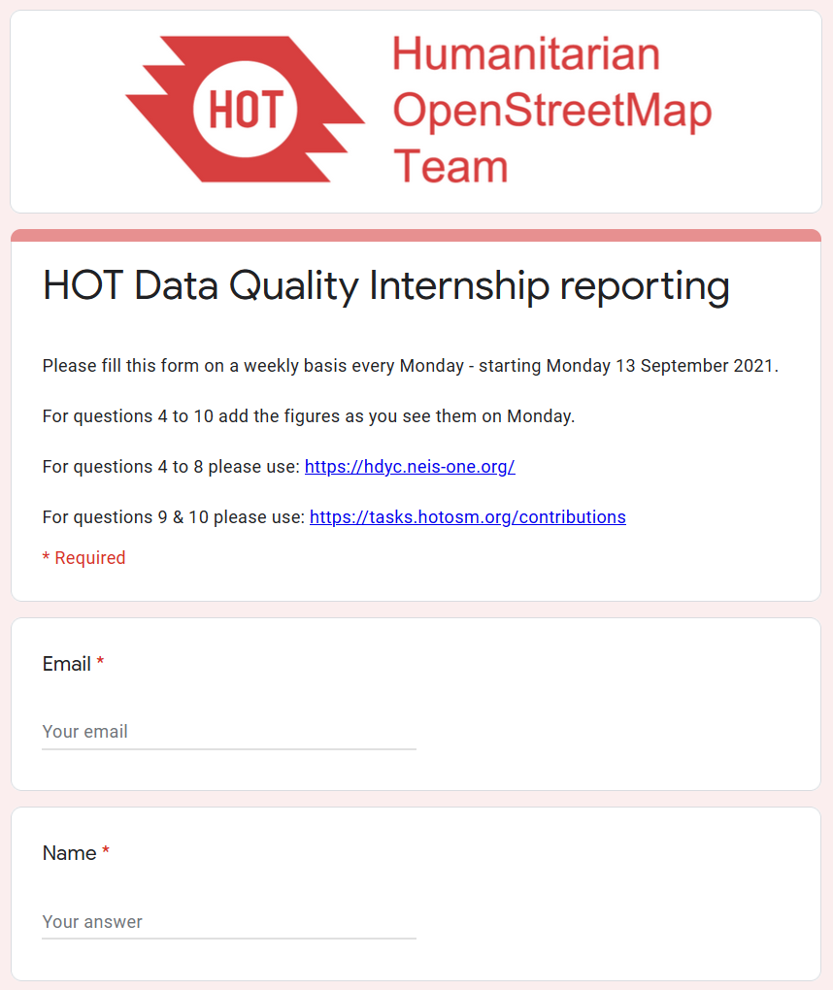
Weekly Reporting
The first day that the form will need to be completed is on Monday 13 September (next week)
From then onwards please complete it every Monday
Notes:
Google Form: https://forms.gle/3DNYE8iVXRS3VE28A

Slide 24

Comms guidance
Photo Requirements
A png or jpg headshot, at least 200x200px
The file name should be your name
Please upload it to this folder
Deadline: Tuesday 7 Sept 11:00 UTC
Notes:
Folder: https://drive.google.com/drive/folders/1O_Bj9TLIKjaiAk_2s7hKNTO5fUYna3Fc?usp=sharing
Please let Sam or Becky Know if you are not confident with publishing your photo on social media, Sam will talk more about that moving forward

Slide 25
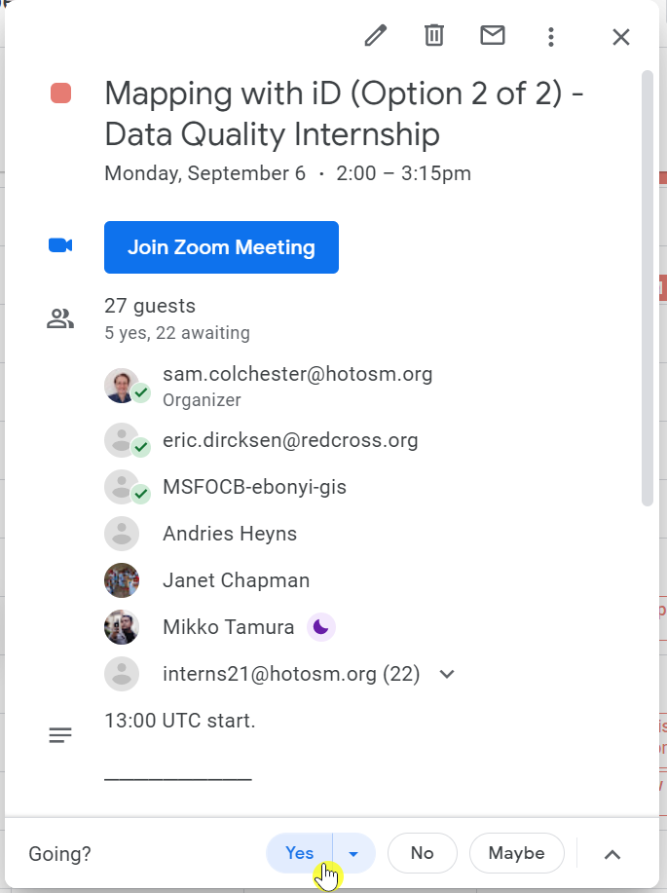
Calendaring and selecting events
Most training sessions are held twice to ensure maximum attendance
Please check which event suits you best and respond ‘Yes’ for those you plan to attend
Sessions will be recorded and viewing links added to calendar events
If you cannot attend a session contact either Sam or Becky beforehand to notify with as much notice as possible
If you need to miss a session, you are expected to watch the recording within 24 hours and report completion to Becky or Sam
Attendance at all sessions will be noted

Slide 26
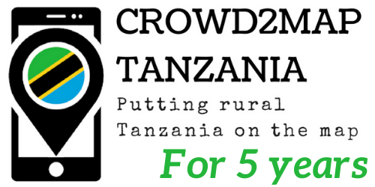



MSF, Red Cross and Crowd2Map
A few participants will be joining some of the training sessions from these organizations
They are all long term partners of HOT and part of the Missing Maps project
It is a good opportunity for you to meet individuals from these organizations!
Notes:
Sam takes over

Slide 27
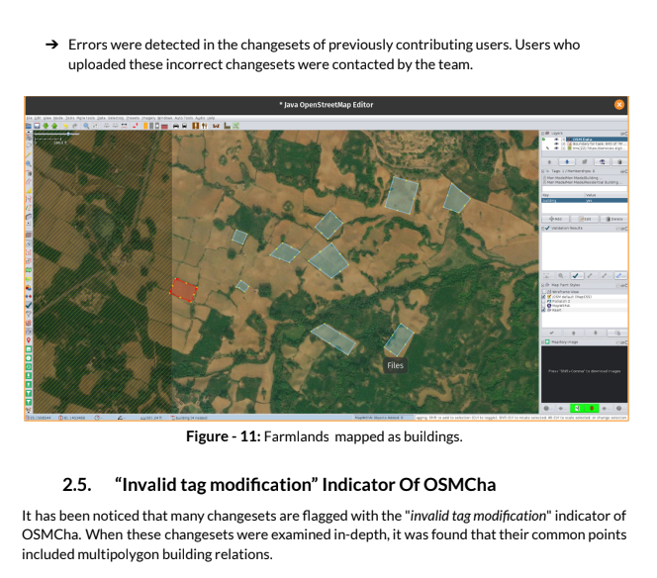
Final Report
Before the end of the internship (by November 26) you are expected to complete a written report (images encouraged!)
It will focus on the data quality of the projects that you have been working on
Much more detail to come later ...

Slide 28
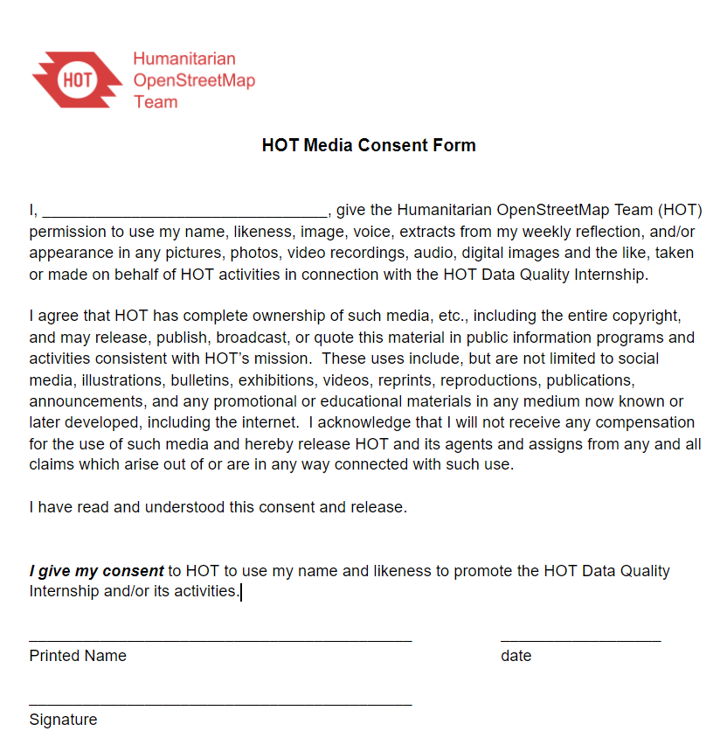
Media Consent Form
Please check this consent form and sign if you are happy with the permissions
This largely relates to using images which have been captured from live Zoom sessions
Deadline: Tuesday 7 Sept 11:00 UTC
Please email signed & completed version to rebecca.chandiru@hotosm.org
Notes:
https://docs.google.com/document/d/177w0H2JmR2beMjVLrp3tJuiHXrj2AfDZXBxwDhFdp5k/edit

Slide 29
HR requirements
Please save either your Passport or national ID.
I will be - Identification" folder created, one folder for each intern,individual folders will be shared through the intern your personal emails.
For the Contracts & Admin meeting on Tuesday please have your bank details ready to share
Notes:
Note: this information (ID & banking details) will be requested to be shared with HOT's HR team ONLY (Emily Bristle & Max Alzaga). Any concerns please let them know.

